Slide 1
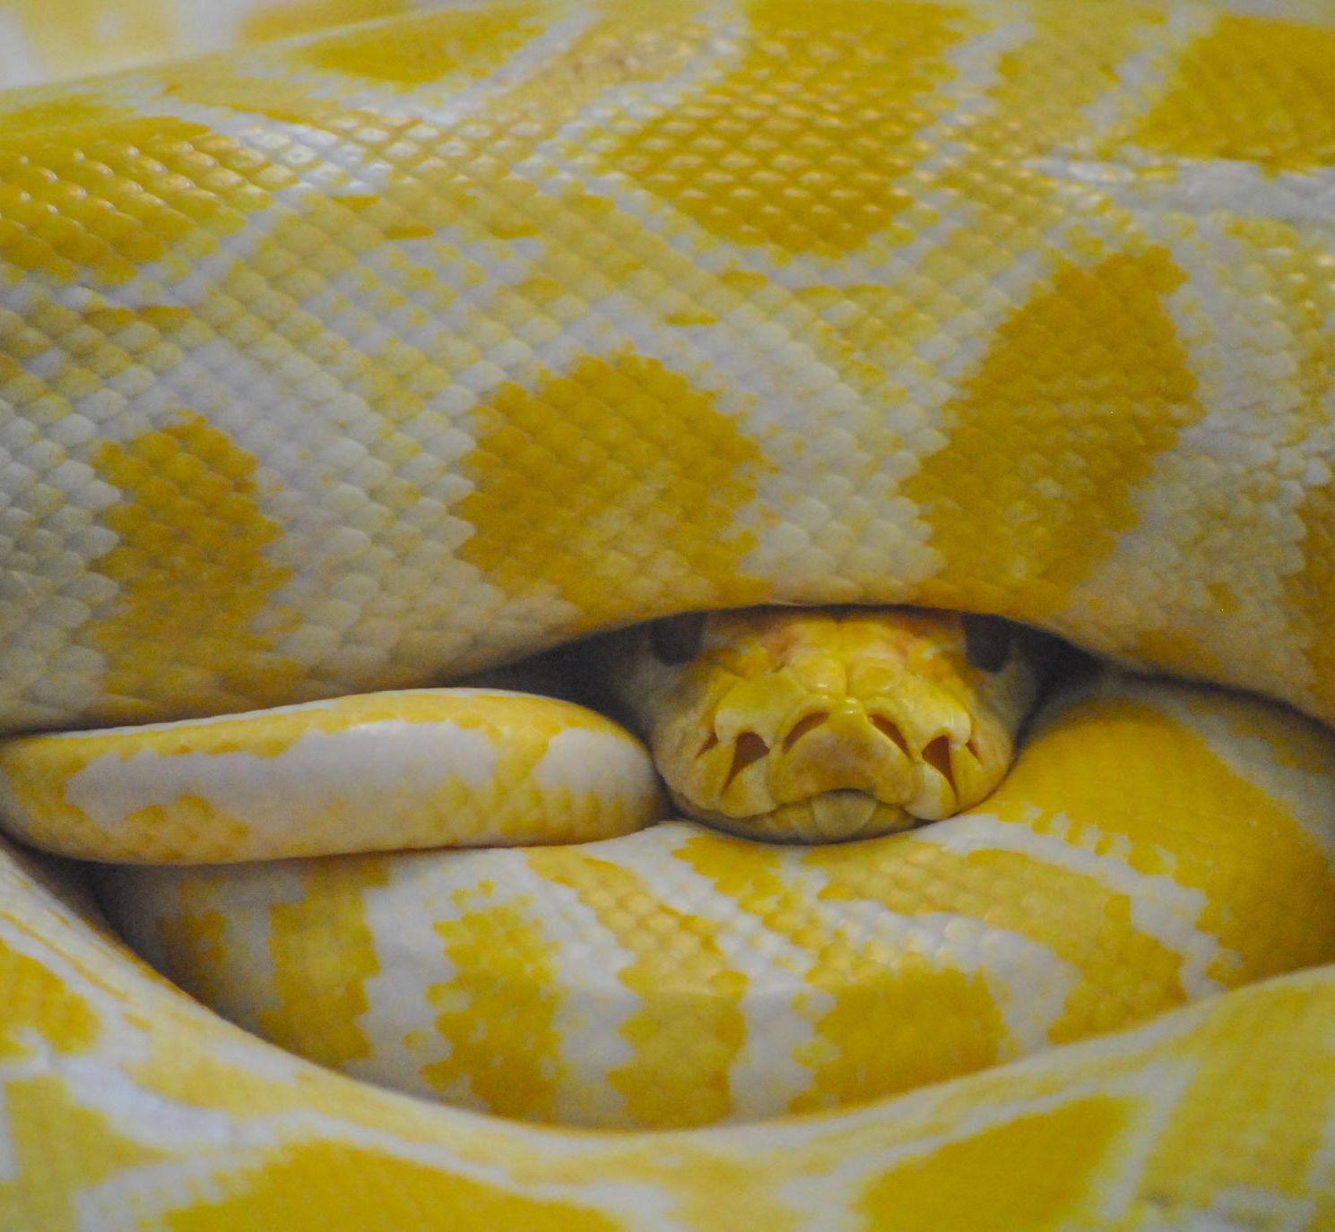

Artificial Neural Network in Python
To: Hayssam serhan
Preseted by:
Charbel azzi
Thierry El Khoury

Slide 2
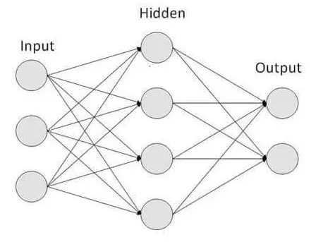
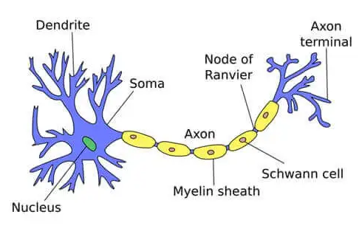
What is a Neural Network
A computational model inspired by the human brain.
Consists of layers of interconnected neurons.
Learns patterns from data through training.
Adjusts internal parameters using optimization algorithms.

Slide 3
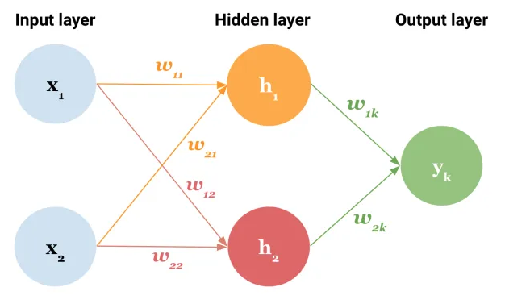
What is a Neural Network
Consists of:
Layers: input, hidden, output.
Weights.
Inputs.
Output.

Slide 4

Objectives
Create neural network to predict cancer diagnosis.
Apply data preprocessing to fit the model.
Train and finetune the network and parameters.
Test the neural network.

Slide 5
Our Approach
Implementation:
Network size.
Learning rate/momentum.
Weight initialization.
Forward calculation.
Backward calculation.

Slide 6
Our Approach
Data Preprocessing:
Normalize the data.
Duplicate entries if needed.
Split into training and testing.
Ensure randomness.

Slide 7
Training
Problems Faced:
Vanishing gradient: too many layers.
False negatives.
Tuning parameters.

Slide 8
Training
How we solved them:
Vanishing gradient: Reduced model complexity by decreasing the number of neurons and layers. Identified the optimal model configuration through experimentation.
False negatives: Augmented the dataset with duplicates of positive cancer samples to increase their representation

Slide 9
Comparison: Different Learning Rates
Learning Rate | Momentum | Error | Accuracy | Correct | False Negatives | False Positives
0.01 | 0.2 | 0.04 | 0.9649 | 110 | 0 | 4
0.02 | 0.2 | 0.04 | 0.9298 | 106 | 0 | 8
0.03 | 0.2 | 0.04 | 0.9474 | 108 | 0 | 6
0.035 | 0.2 | 0.04 | 0.9298 | 106 | 0 | 8
0.04 | 0.2 | 0.04 | 0.9298 | 106 | 0 | 8
0.045 | 0.2 | 0.04 | 0.9561 | 109 | 0 | 5
0.05 | 0.2 | 0.04 | 0.9386 | 107 | 0 | 7
0.06 | 0.2 | 0.04 | 0.9386 | 107 | 0 | 7

Slide 10
Comparison: Different Momentums
Momentum | Learning Rate | Error | Accuracy | Correct | False Negatives | False Positives
0.075 | 0.03 | 0.04 | 0.9474 | 108 | 0 | 6
0.07 | 0.03 | 0.04 | 0.9298 | 106 | 0 | 8
0.12 | 0.03 | 0.04 | 0.9123 | 104 | 0 | 10
0.17 | 0.03 | 0.04 | 0.9123 | 104 | 0 | 10
0.1 | 0.03 | 0.04 | 0.9561 | 109 | 0 | 5
0.2 | 0.03 | 0.04 | 0.9123 | 104 | 0 | 10
0.3 | 0.03 | 0.04 | 0.9737 | 111 | 0 | 3
0.9 | 0.03 | 0.04 | 0.9386 | 107 | 2 | 5

Slide 11
Comparison: Different Error Thresholds
Error | Momentum | Learning Rate | Accuracy | Correct | False Negatives | False Positives
0.012 | 0.2 | 0.03 | 0.9649 | 110 | 1 | 3
0.01 | 0.2 | 0.03 | 0.9737 | 111 | 1 | 2
0.022 | 0.2 | 0.03 | 0.9561 | 109 | 1 | 4
0.028 | 0.2 | 0.03 | 0.9386 | 107 | 0 | 7
0.035 | 0.2 | 0.03 | 0.9474 | 108 | 0 | 6
0.03 | 0.2 | 0.03 | 0.9737 | 111 | 0 | 3
0.046 | 0.2 | 0.03 | 0.9474 | 108 | 0 | 6
0.05 | 0.2 | 0.03 | 0.8947 | 102 | 0 | 12

Slide 12
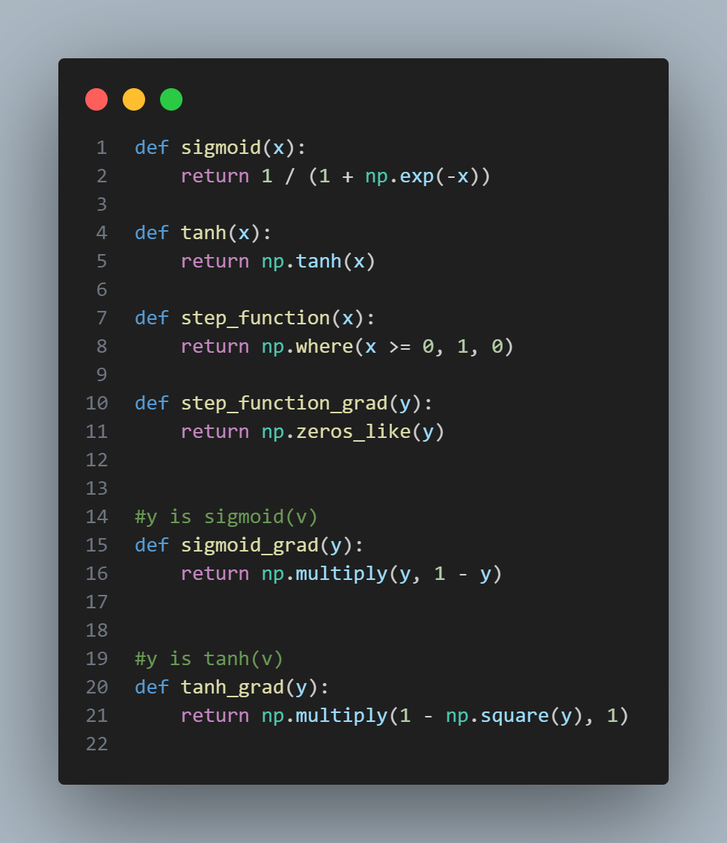
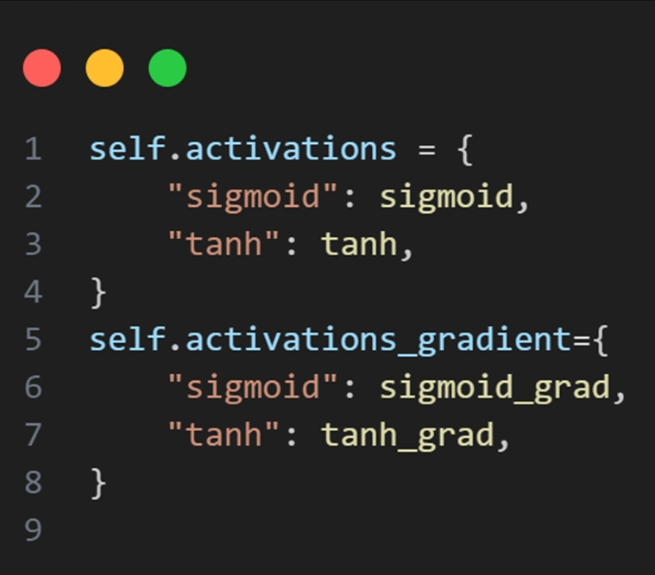
Code
Dynamic Activation Functions

Slide 13
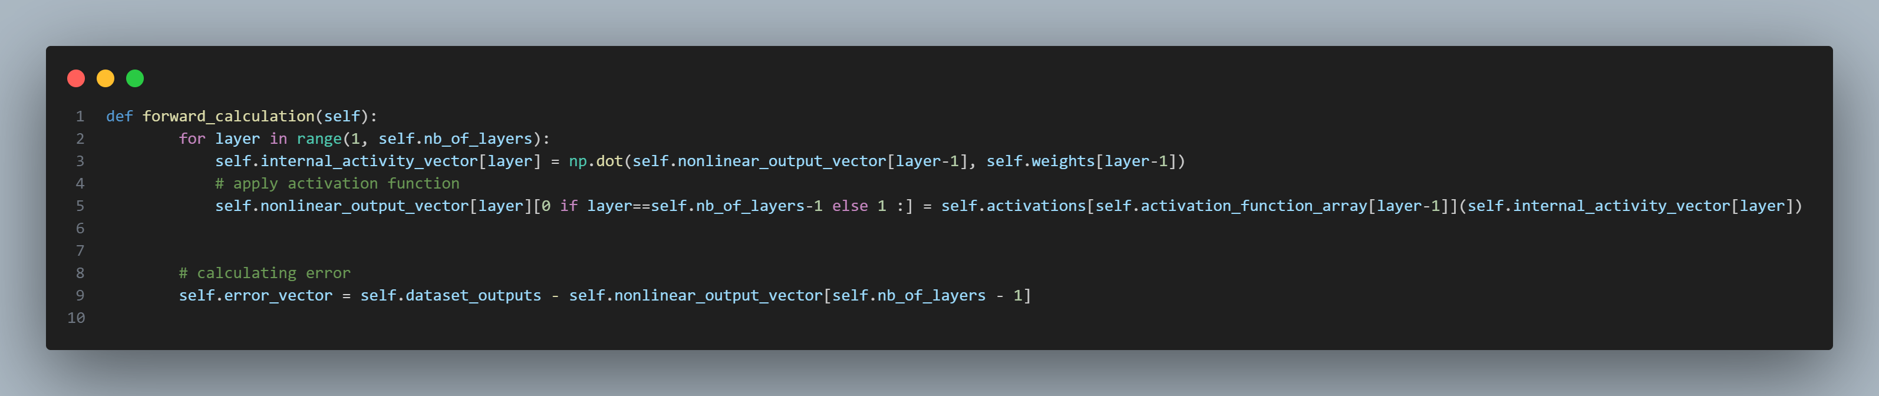
Code
Forward Calculation:

Slide 14
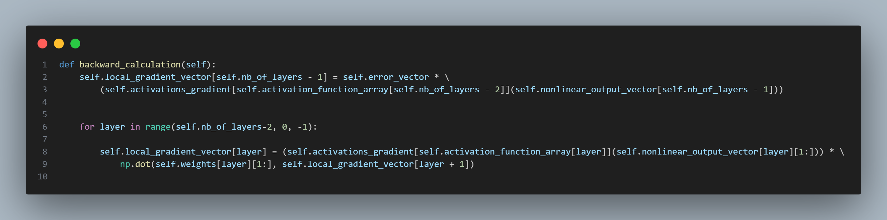
Code
Backward Calculation:

Slide 15
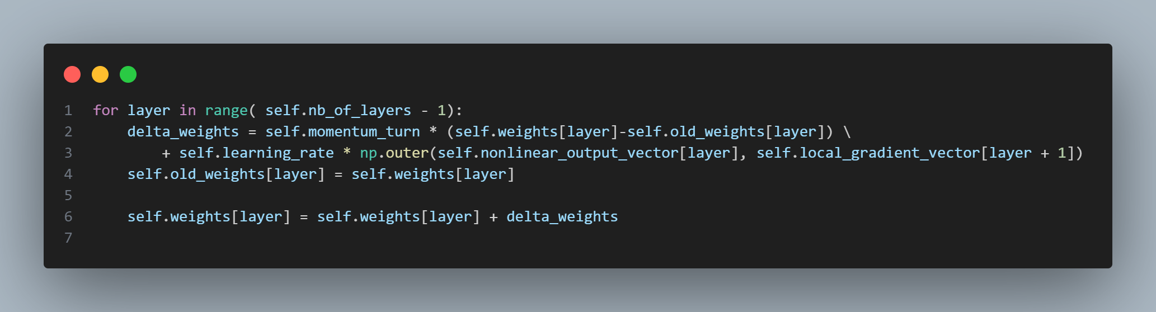
Code
Backward Calculation (Cont):

Slide 16
Thank You

